Slide 1
CSE419 – Artificial Intelligence and Machine Learning 2020 PhD Furkan Gözükara, Toros University https://github.com/FurkanGozukara/CSE419-Artificial-Intelligence-and-Machine-Learning-2020
Lecture 1
Introduction
Composed from Asst. Prof. Dr. Senem Kumova Metin’s Resources
Source: https://cs.pomona.edu/~dkauchak/classes/f13/cs451-f13/lectures/

Slide 2
Dictionary Definitions of Intelligence
“The ability to use memory, knowledge, experience, understanding, reasoning, imagination and judgment in order to solve problems and adapt to new situations.” AllWords Dictionary, 2006
“The ability to learn or understand or to deal with new or difficult situations” (Merriam Webster)
“The capacity for understanding; ability to perceive and comprehend meaning” (Collins)
“The ability to acquire and apply knowledge and skills” (Oxford Dictionary, 2006)
Notes:
Perceive algılamak comprehend kavramak idrak etmek

Slide 3
Overview of Artificial Intelligence (AI) (1/3)
Artificial intelligence (AI)
Computers with the ability to mimic or duplicate the functions of the human brain
The term was coined in 1956 by John McCarthy at the Massachusetts Institute of Technology
Artificial intelligence systems
The people, procedures, hardware, software, data, and knowledge needed to develop computer systems and machines that demonstrate the characteristics of intelligence
Notes:
Coin söz türetmek

Slide 4
Overview of Artificial Intelligence (AI) (2/3)
Intelligent behavior
Learn from experience
Apply knowledge acquired from experience
Handle complex situations
Solve problems when important information is missing
Determine what is important
React quickly and correctly to a new situation
Understand visual images
Process and manipulate symbols
Be creative and imaginative
Use heuristics

Slide 5
Design methodology and goals
The exciting new effort to make computers thinks … machine with minds, in the full and literal sense”
(Haugeland 1985)
“The study of mental faculties through the use of computational models”
(Charniak et al. 1985)
“The art of creating machines that perform functions that require intelligence when performed by people” (Kurzweil, 1990)
A field of study that seeks to explain and emulate intelligent behavior in terms of computational processes” (Schalkol, 1990)
Systems that think like humans
Systems that think rationally
Systems that act like humans
Systems that act rationally

Slide 6
Systems that act like humans
Behaviorist approach.
Not interested in how you get results, just the similarity to what human results are.
ELIZA: one of the first chatterbots and one of the first programs capable of attempting the Turing Test.
Turing Test: a test for intelligence in a computer, requiring that a human being should be unable to distinguish the machine from another human being by using the replies to questions put to both.
Notes:
Behaviorist davranışçı

Slide 7
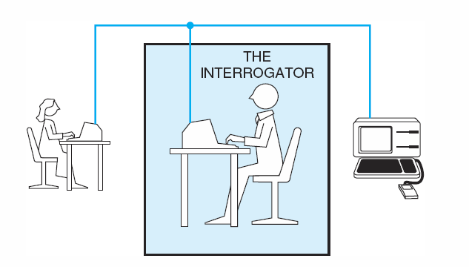
Acting Humanly: The Turing Test
Alan Turing's 1950 article Computing Machinery and Intelligence discussed conditions for considering a machine to be intelligent

Slide 8
Acting Humanly: The Turing Test
Interrogator asks questions of two “people” who are out of sight and hearing. One is a human, the other one a machine.
30mins to ask whatever she/he wants.
To determine only through questions and answers which is which.
If the interrogator cannot distinguish between human and computer, the machine has passed the test!

Slide 9
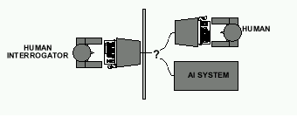
Acting Humanly: The Turing Test
Computer needs to possess:
Natural language processing
Knowledge representation
Automated reasoning
Machine learning

Slide 10
What would a computer need to pass the Turing test?
Natural language processing: to communicate with examiner.
Knowledge representation: to store and retrieve information provided before or during interrogation.
Automated reasoning: to use the stored information to answer questions and to draw new conclusions.
Machine learning: to adapt to new circumstances and to detect and extrapolate patterns.
Notes:
Extrapolate verilerden bilinmeyene ulaşmak tahmin etmek

Slide 11
Acting Humanly: The Full Turing Test
Problems:
1) Turing test is not reproducible, constructive, and amenable to mathematic analysis.
2) What about physical interaction with interrogator and environment?
Total (Full) Turing Test: Requires physical interaction and needs perception and actuation.
Notes:
Amenable uygun uyumlu , actuation haraket

Slide 12
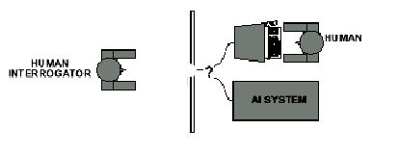
Acting Humanly: The Full Turing Test
Computer needs to possess:
Natural language processing
Knowledge representation
Automated reasoning (AR)
Machine learning (MR)
and
Computer Vision
Robotics
Trap door

Slide 13
What would a computer need to pass the full Turing test?
Natural language processing
Knowledge representation
Automated reasoning (AR)
Machine learning (MR)
Vision : to recognize the examiner’s actions and various objects presented by the examiner.
Robotics : to manipulate objects and move about

Slide 14
Systems that think like humans
Focus not just on behavior and I/O, look at reasoning process.
Computational model should reflect "how" results were obtained.
GPS (General Problem Solver): Goal not just to produce humanlike behavior (like ELIZA), but to produce a sequence of steps of the reasoning process that was similar to the steps followed by a person in solving the same task.

Slide 15
Thinking Humanly: Cognitive Science
Thinking like a human → Determining how humans think …
Cognitive science brings together theories and experimental evidence to model internal activities of the brain
Notes:
Cognitive kavramsal bilişsel

Slide 16
Systems that think rationally
Formalize the reasoning process, producing a system that contains logical inference mechanisms that are provably correct, and guarantee finding an optimal solution.
This brings up the question: How do we represent information that will allow us to do inferences?
Notes:
Inference çıkarım çıkarsama anlam çıkarma , provably kanıtlanabilir şekilde

Slide 17
Thinking Rationally: Laws of Thought
Aristotle (~ 450 B.C.) attempted to codify “right thinking” What are correct arguments/thought processes?
E.g., “Socrates is a man, all men are mortal; therefore Socrates is mortal”
The Law of Thought approach initiated the field called LOGIC…

Slide 18
Thinking Rationally: Laws of Thought
Problems:
Uncertainty: Not all facts are certain (e.g., the flight might be delayed).
It is not easy to take informal knowledge and state in formal terms required by logical notation , particularly when the knowledge is less than 100% certain
2) Resource limitations:
Not enough time to compute/process
Insufficient memory/disk/etc
etc.

Slide 19
Systems that act rationally
For a given set of inputs, tries to generate an appropriate output that is not necessarily correct but gets the job done.
Rational and sufficient (“satisficing” methods, not “optimal”).

Slide 20
Acting Rationally: The Rational Agent Approach
Rational behavior: Doing the right thing!
The right thing: That which is expected to maximize the expected return
Provides the most general view of AI because it includes:
Correct inference (“Laws of thought”)
Uncertainty handling
Resource limitation considerations (e.g., reflex vs. deliberation)
Cognitive skills (NLP, AR, knowledge representation, ML, etc.)
Advantages:
More general
Its goal of rationality is well defined
Notes:
Deliberation tartışma düşünüp taşınma tasarlama kafa yorma

Slide 21
Acting Rationally: The Rational Agent Approach
An agent is something that acts
A computer agent is a program that
operates under autonomous control,
perceives the environment,
persists over a prolonged time period,
adapts to change,
is capable of taking another’s goal
A rational agent is the agent that acts so as to achieve best outcome or when there is uncertainty the best expected outcome.

Slide 22
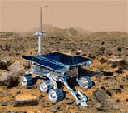

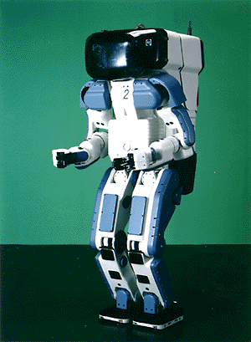

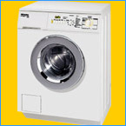
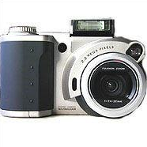

Why study AI?
Search engines
Science
Medicine/
Diagnosis
Labor
Appliances
What else?

Slide 23
Applications of AI
Game Playing Deep Blue Chess program beat world champion Gary Kasparov
Speech Recognition PEGASUS spoken language interface to American Airlines' EAASY SABRE reservation system, which allows users to obtain flight information and make reservations over the telephone. The 1990s has seen significant advances in speech recognition so that limited systems are now successful.
Computer Vision
Face recognition programs in use by banks, government, etc.
The ALVINN system from CMU autonomously drove a van from Washington, D.C. to San Diego (all but 52 of 2,849 miles), averaging 63 mph day and night, and in all weather conditions.
Handwriting recognition, electronics and manufacturing inspection, photo interpretation, baggage inspection, reverse engineering to automatically construct a 3D geometric model.

Slide 24
Applications of AI
Expert Systems
Application-specific systems that rely on obtaining the knowledge of human experts in an area and programming that knowledge into a system.
Diagnostic Systems
Microsoft Office Assistant provides customized help by decision-theoretic reasoning about an individual user.
MYCIN system for diagnosing bacterial infections of the blood and suggesting treatments.
Pathfinder medical diagnosis system, which suggests tests and makes diagnoses.
Notes:
Theoretic kuramsal teorik

Slide 25
Applications of AI
Financial Decision Making
Credit card companies, mortgage companies, banks, and the U.S. government employ AI systems to detect fraud and expedite financial transactions.
Systems often use learning algorithms to construct profiles of customer usage patterns, and then use these profiles to detect unusual patterns and take appropriate action.
Classification Systems
Put information into one of a fixed set of categories using several sources of information. E.g., financial decision making systems.
NASA developed a system for classifying very faint areas in astronomical images into either stars or galaxies with very high accuracy by learning from human experts' classifications.
Notes:
Expedite hızlandırmak çabuklaştırmak kolaylaştırmak

Slide 26
Applications of AI
Mathematical Theorem Proving
Use inference methods to prove new theorems.
Natural Language Understanding
Google's translation of web pages. Translation of Caterpillar Truck manuals into 20 languages. (Note: One early system translated the English sentence "The spirit is willing but the flesh is weak" into the Russian equivalent of "The vodka is good but the meat is rotten.")

Slide 27
Applications of AI
Scheduling and Planning
Automatic scheduling for manufacturing.
DARPA's DART system used in Desert Storm and Desert Shield operations to plan logistics of people and supplies.
American Airlines rerouting contingency planner.
European space agency planning and scheduling of spacecraft assembly, integration and verification.
Robotics and Path planning
NASA’s Rover mission.
Biology and medicine
Modeling of cellular functions, analysis of DNA and proteins.
and…
Notes:
Contingency olası ihtimal beklenmedik olay

Slide 28
How to achieve AI?
How is AI research done?
AI research has both theoretical and experimental sides. The experimental side has both basic and applied aspects.
There are two main lines of research:
One is biological, based on the idea that since humans are intelligent, AI should study humans and imitate their psychology or physiology.
The other is phenomenal, based on studying and formalizing common sense facts about the world and the problems that the world presents to the achievement of goals.
The two approaches interact to some extent, and both should eventually succeed. It is a race, but both racers seem to be walking. [John McCarthy]
Notes:
Phenomenal olağanüstü, az sayıda, şaşılacak

Slide 29
Major Branches of AI (1/3)
Perceptive system
A system that approximates the way a human sees, hears, and feels objects
Vision system
Capture, store, and manipulate visual images and pictures
Robotics
Mechanical and computer devices that perform tedious tasks with high precision
Expert system
Stores knowledge and makes inferences

Slide 30
Major Branches of AI (2/3)
Learning system
Computer changes how it functions or reacts to situations based on feedback
Natural language processing
Computers understand and react to statements and commands made in a “natural” language, such as English
Neural network
Computer system that can act like or simulate the functioning of the human brain

Slide 31
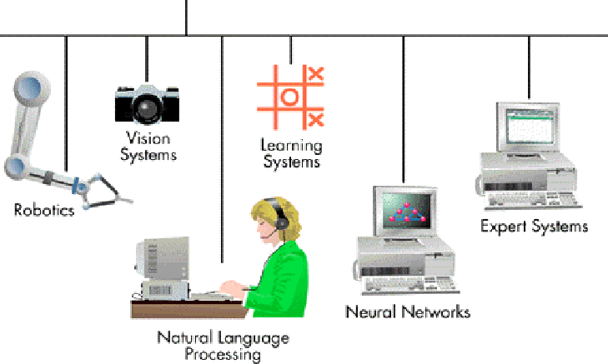
Major Branches of AI (3/3)
Artificial intelligence

Slide 32
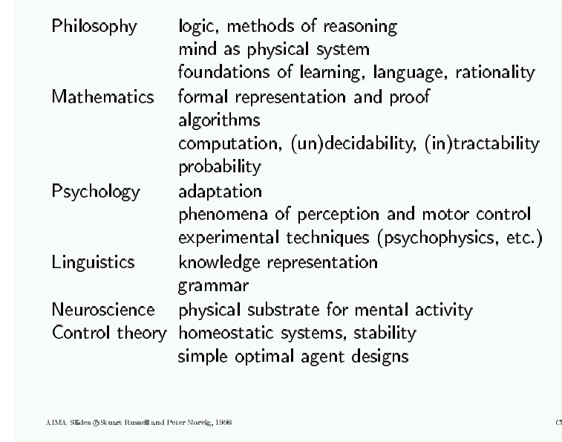
AI Prehistory
Notes:
Tractability uysalık kolay işlenebilirlik, intractability densizlik dik kafalılık, psychophysics pisoko fiziki , substrate alt katman alt madde

Slide 33
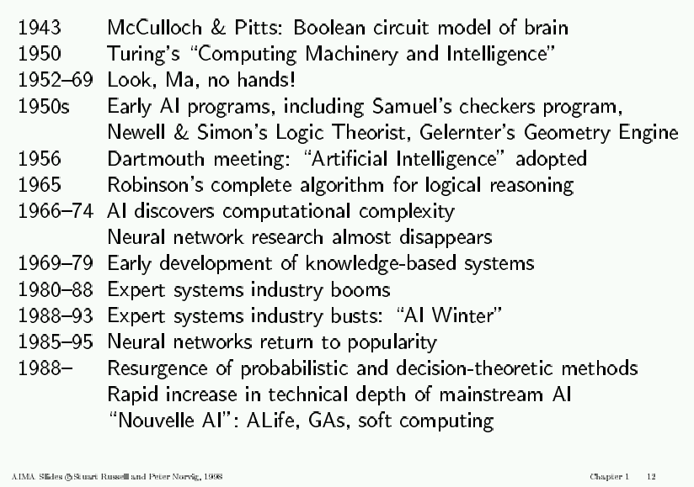
AI History

Slide 34
AI State of the art
Have the following been achieved by AI?
World-class chess playing
Playing table tennis
Cross-country driving
Solving mathematical problems
Discover and prove mathematical theories
Engage in a meaningful conversation
Understand spoken language
Observe and understand human emotions
Express emotions
…

Slide 35
Special Topics: An Introduction ☺
Natural Language Processing
Robotics
Machine Learning
Expert Systems
Genetic Algorithms
Information Retrieval
Planning
Vision
Neural Networks
Notes:
Expert systems a piece of software which uses databases of expert knowledge to offer advice or make decisions in such areas as medical diagnosis.

Slide 36
Natural Language Processing
Natural Language Processing
Process information contained in natural language text.
Also known as Computational Linguistics (CL), Human Language Technology (HLT), Natural Language Engineering (NLE)
Can machines understand human language?
Define ‘understand’
Understanding is the ultimate goal. However, one doesn’t need to fully understand to be useful.

Slide 37
Natural Language Processing
Analyze, understand and generate human languages just like humans do.
Applying computational techniques to language domain..
To explain linguistic theories, to use the theories to build systems that can be of social use..
Started off as a branch of Artificial Intelligence..
Borrows from Linguistics, Psycholinguistics, Cognitive Science & Statistics.
Make computers learn our language rather than we learn theirs
Notes:
Psycholinguistics ruh dil bilim the branch of cognitive psychology that studies the psychological basis of linguistic competence and performance

Slide 38
Natural Language Processing
The input/output of a NLP system can be:
written text
speech
To process written text, we need:
lexical, syntactic, semantic knowledge about the language
discourse information, real world knowledge
To process spoken language, we need everything required to process written text, plus the challenges of speech recognition and speech synthesis.
Notes:
Lexical sözcüksel sözcüklere ait, syntactic söz dizimsel sentaktik, semantic anlamsal anlambilimsel kelime anlamı, discourse söylem konuşma nutuk , işlemek, konuşmak

Slide 39
NLP Applications
Question answering
Who is the first Taiwanese president?
Text Categorization/Routing
e.g., customer e-mails.
Text Mining
Find everything that interacts with BRCA1.
Machine (Assisted) Translation
Language Teaching/Learning
Usage checking
Spelling correction
Is that just dictionary lookup?

Slide 40


Robotics
Word robot was coined by a Czech novelist Karel Capek in a 1920 play titled Rossum’s Universal Robots (RUR)
Robota in Czech is a word for worker or servant
Karel Capek
Definition of robot:
A robot is a reprogrammable, multifunctional manipulator designed to move material, parts, tools or specialized devices through variable programmed motions for the performance of a variety of tasks: Robot Institute of America, 1979

Slide 41
Robotics: Key Components
Power conversion
unit
Sensors
Actuators
Controller
User interface
Manipulator linkage
Base

Slide 42
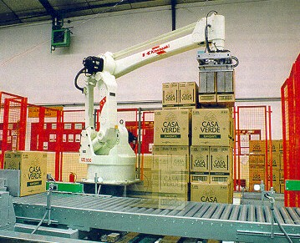
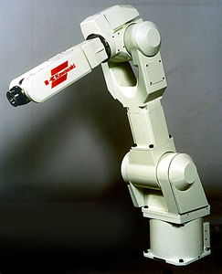
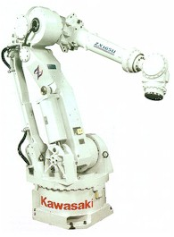
Robotics: What Can Robots Do?
Industrial Robots
Material handling
Material transfer
Machine loading and/or unloading
Spot welding
Continuous arc welding
Spray coating
Assembly
Inspection
Material Handling Manipulator
Spot Welding Manipulator
Assembly Manipulator

Slide 43
NLP Applications
Question answering
Who is the first Taiwanese president?
Text Categorization/Routing
e.g., customer e-mails.
Text Mining
Find everything that interacts with BRCA1.
Machine (Assisted) Translation
Language Teaching/Learning
Usage checking
Spelling correction
Is that just dictionary lookup?

Slide 44
Machine Learning
Adapt to / learn from data
To optimize a performance function
Can be used to:
Extract knowledge from data
Learn tasks that are difficult to formalize
Create software that improves over time

Slide 45
Machine Learning
Machine learning is programming computers to optimize a performance criterion using example data or past experience.
Learning is used when:
Human expertise does not exist (navigating on Mars),
Humans are unable to explain their expertise (speech recognition)
Solution changes in time (routing on a computer network)
Solution needs to be adapted to particular cases (user biometrics)

Slide 46
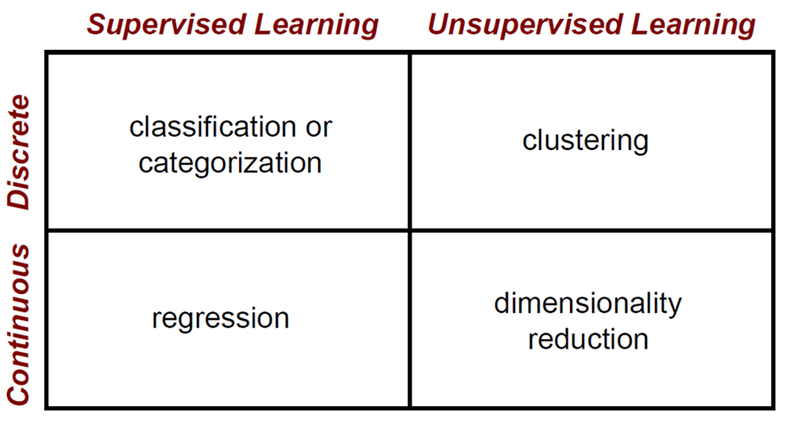
Machine Learning
Notes:
Regression is basically a statistical approach to find the relationship between variables. In machine learning, this is used to predict the outcome of an event based on the relationship between variables obtained from the data-set.

Slide 47
Machine Learning : Classification: Applications
Face recognition: Pose, lighting, occlusion (glasses, beard), make-up, hair style
Character recognition: Different handwriting styles.
Speech recognition: Temporal dependency.
Use of a dictionary or the syntax of the language.
Sensor fusion: Combine multiple modalities; e.g., visual (lip image) and acoustic for speech
Medical diagnosis: From symptoms to illnesses
Web Advertising: Predict if a user clicks on an ad on the Internet.
etc.
Notes:
Occlusion kapanma

Slide 48








Machine Learning : Face Recognition
Training examples of a person
Test images
AT&T Laboratories, Cambridge UK
http://www.uk.research.att.com/facedatabase.html

Slide 49
Expert Systems
The term expert system is used in a paper by Alan Turing in 1937 related to a study in AI.
An Expert System (ES) is a computer program that reasons using knowledge to solve complex problems. (Feigenbaum, 1992)
Traditionally, computers solve complex problems by arithmetic calculations; and the knowledge to solve the problem is only known by the human programmer.

Slide 50
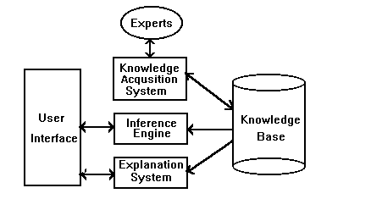
Expert Systems: Architecture

Slide 51
Genetic Algorithms
A class of probabilistic optimization algorithms
Inspired by the biological evolution process
Originally developed by John Holland (1975)

Slide 52
Genetic Algorithms

Slide 53
Genetic Algorithms : Some GA Application Types
Notes:
Trajectory yörünge mermi yolu

Slide 54
Information Retrieval (IR)
Goal = find documents relevant to an information need from a large document set
Info. need
Query
Document
collection
IR system
Retrieval
Answer list

Slide 55

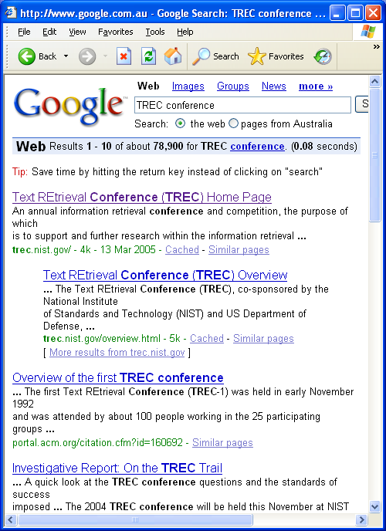
Information Retrieval
Google
Web

Slide 56
IR: Possible approaches
1. String matching (linear search in documents)
- Slow
- Difficult to improve
2. Indexing (*)
- Fast
- Flexible to further improvement

Slide 57
IR: Indexed Based IR Systems
Document Query
indexing indexing
(Query analysis)
Representation Representation
(keywords) Query (keywords)
evaluation

Slide 58
Planning
The task of coming up with a sequence of actions that will achieve a goal is called planning.
It contains both how to take actions in the world (the search based problem solving agents) and how to represent objects, relations and so on (the logical planning agents).
Scheduling + Game Playing

Slide 59
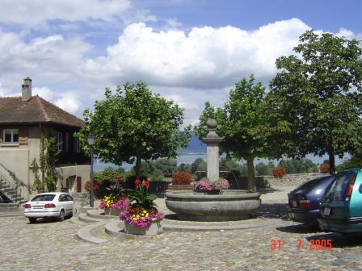
Computer Vision
Make computers understand images and video.
What kind of scene?
Where are the cars?
How far is the building?
…

Slide 60
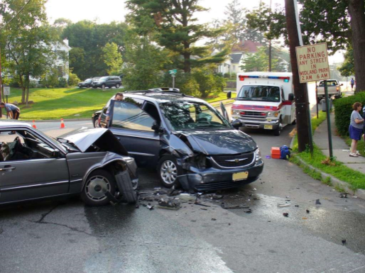
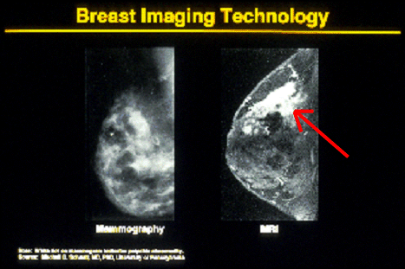

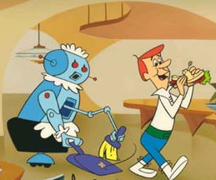
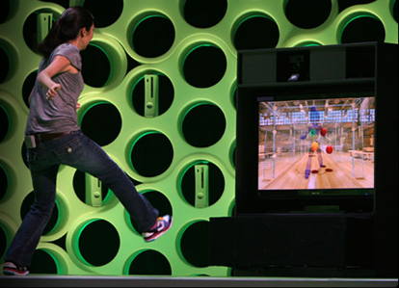

Why computer vision matters
Safety
Health
Security
Comfort
Fun
Access

Slide 61
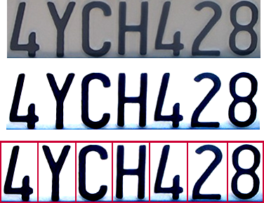
Computer Vision : Optical character recognition (OCR)
Technology to convert scanned docs to text
If you have a scanner, it probably came with OCR software
Digit recognition, AT&T labs
http://www.research.att.com/~yann/
License plate readers
http://en.wikipedia.org/wiki/Automatic_number_plate_recognition

Slide 62
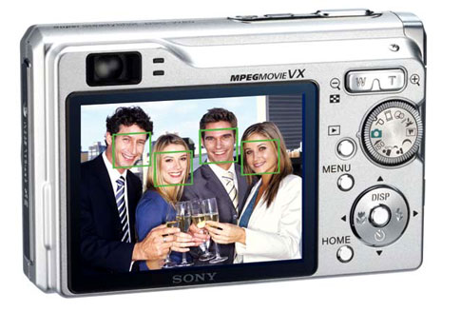
Computer Vision : Face detection
Many new digital cameras now detect faces
Canon, Sony, Fuji, …
Notes:
Why would this be useful? Main reason is focus. Also enables “smart” cropping.

Slide 63
Neural Networks
A mathematical model to solve engineering problems
Group of highly connected neurons to realize compositions of non linear functions
Tasks
Classification
Discrimination
Estimation
2 types of networks
Feed forward Neural Networks
Recurrent Neural Networks

